Slide 1

A Deeper Dive into Home & Community-Based Services (HCBS) Medicaid Waivers
GCDD HCBS Advocacy Day
January 27, 2021

Slide 2






Agenda
A History of the Waiver Waitlist
The Importance of Advocacy
The Current Waiver Waitlist
Today’s Advocacy Ask
Bonus Ask

Slide 3
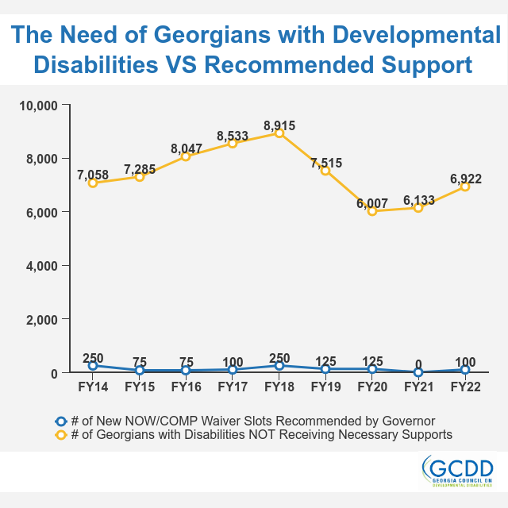
A History of the Waiver Waitlist

Slide 4
The Importance of Advocacy
  Last Year’s Example:
    Over 6,000 on the waitlist
    Governor’s Recommendation: 0 new waiver slots
    State Agencies took 10-14% budget cut
    Advocates added $5,599,600 for 100 new slots!

Slide 5
The Current Waiver Waitlist
  # of Georgians receiving waivers: ~13,000
  # of Georgians waiting: 6,922
    Up from 6,133 in May 2020
  # of new slots recommended in new budget: 100
  # of new slots over the last 3 years: 325
  # of new waiver recipients over last 3 years: ~700
  DBHDD’s 3 year goal: 1,950 new waiver recipients

Slide 6
Today’s Advocacy Ask
  We are asking for 250 new waiver slots, in addition to the Governor’s recommendation of 100, totaling 350*
  We believe this will help DBHDD come closer to achieving its goal of serving 1,950 new waiver recipients by year 3
*We know increasing waiver slots by 100-200 each year is not an effective strategy to address the almost 7,000 Georgians whose needs are not being met, some for decades, and we are asking you to join us in developing a strategy that works moving forward.

Slide 7
Bonus Ask
  People with developmental disabilities need access to the vaccine NOW!
  COVID is a SERIOUS health risk for people with disabilities
  Make the BONUS ASK each time:
We need your help getting access to the COVID vaccine. People with developmental disabilities are not prioritized until 1C, which is unacceptable given the high risk of serious COVID complications for people with developmental disabilities. Please encourage Governor Kemp to include our community in earlier phases.

